Slide 1
MEYE PRO WITH TIMETABLE
2019-ARID-2931 (ABDUL SAMI)
2019-ARID-2945 (ALI HASNAIN)
2019-ARID-3037 (M. MUZAMMIL)
2019-ARID-2952 (AQSA SHAFEEQ)

Slide 2
Flutter View

Slide 3
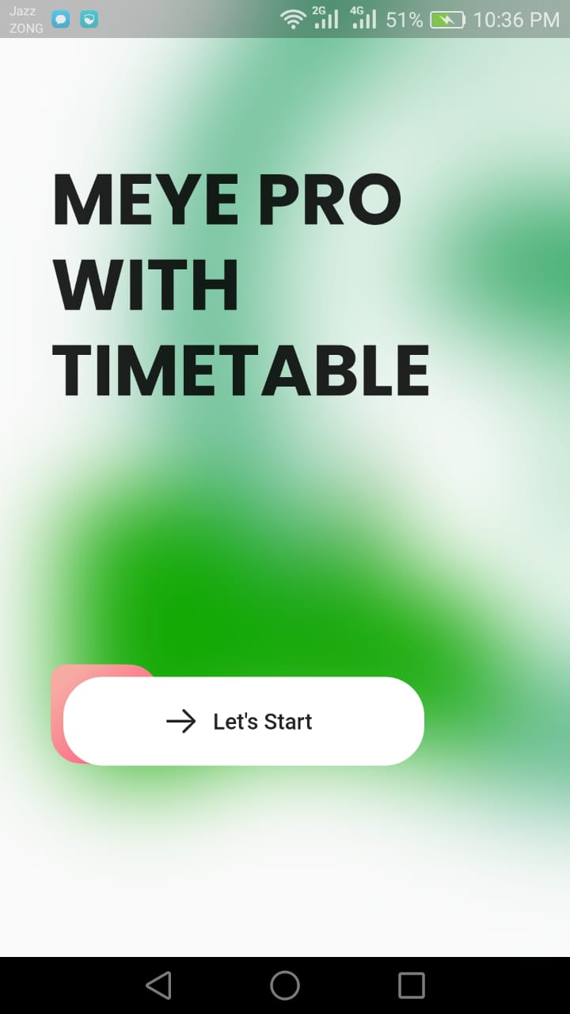
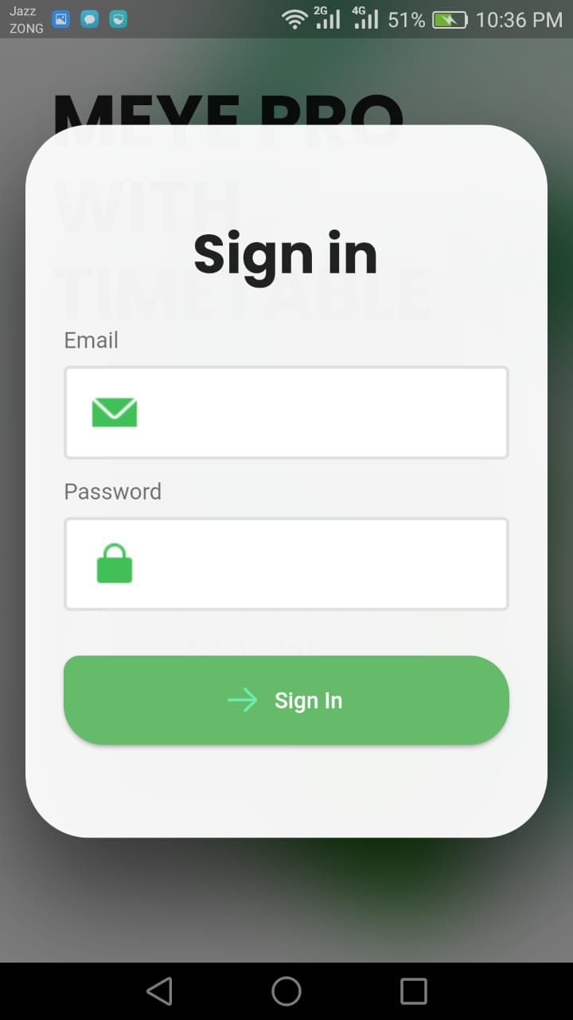
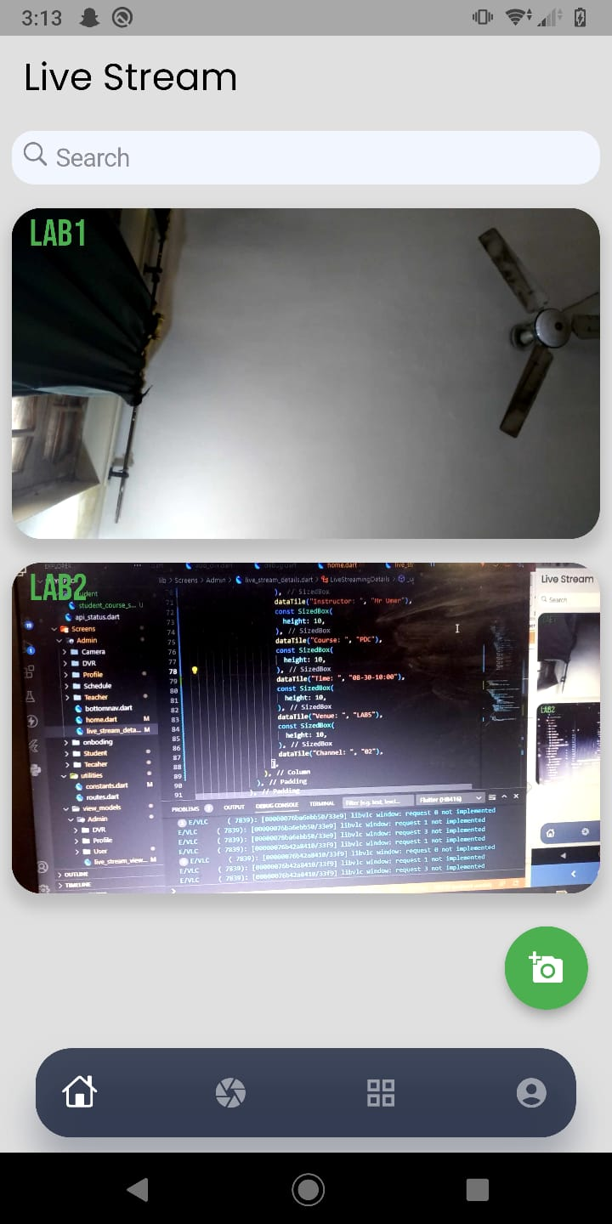
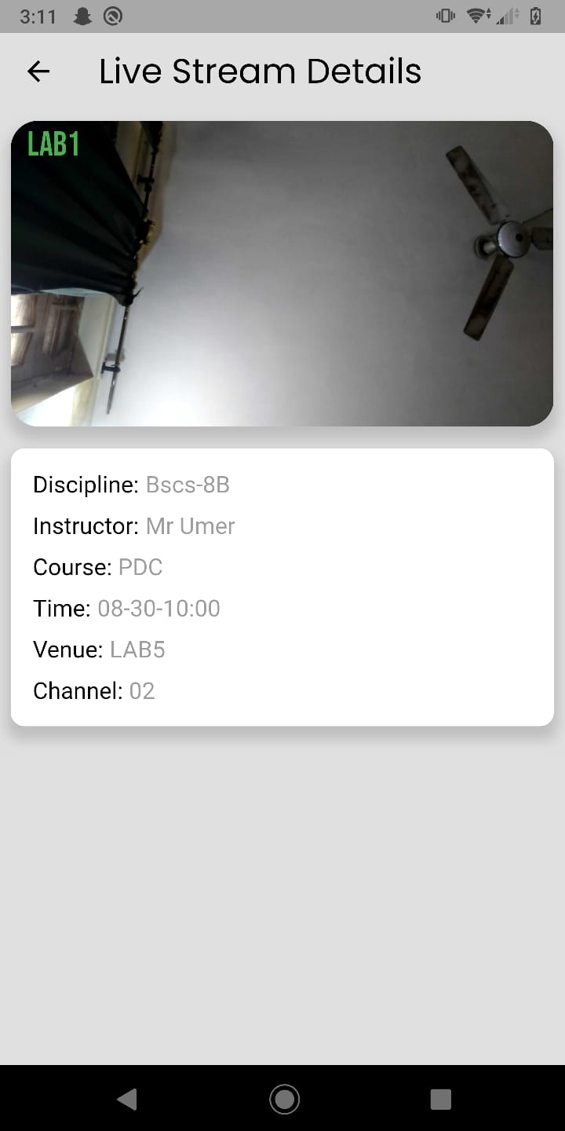
Admin Dashboard

Slide 4
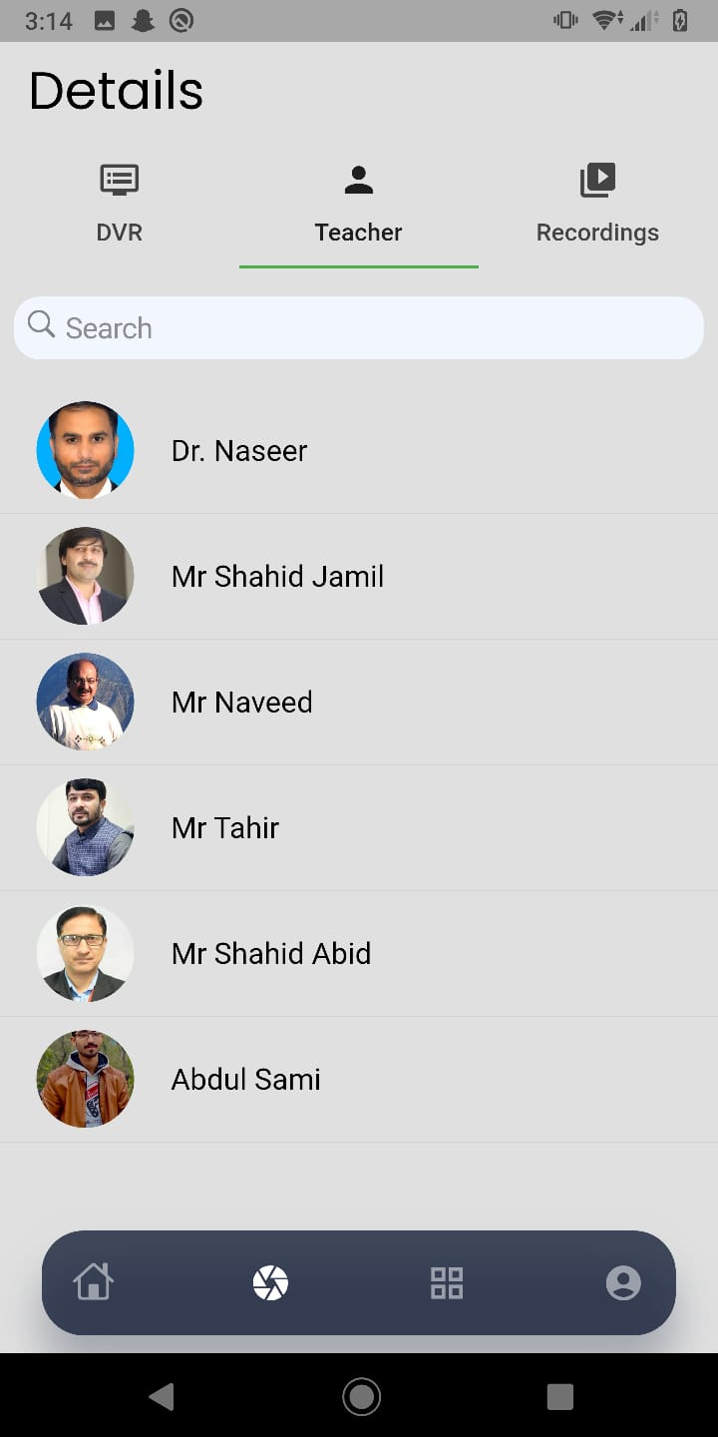
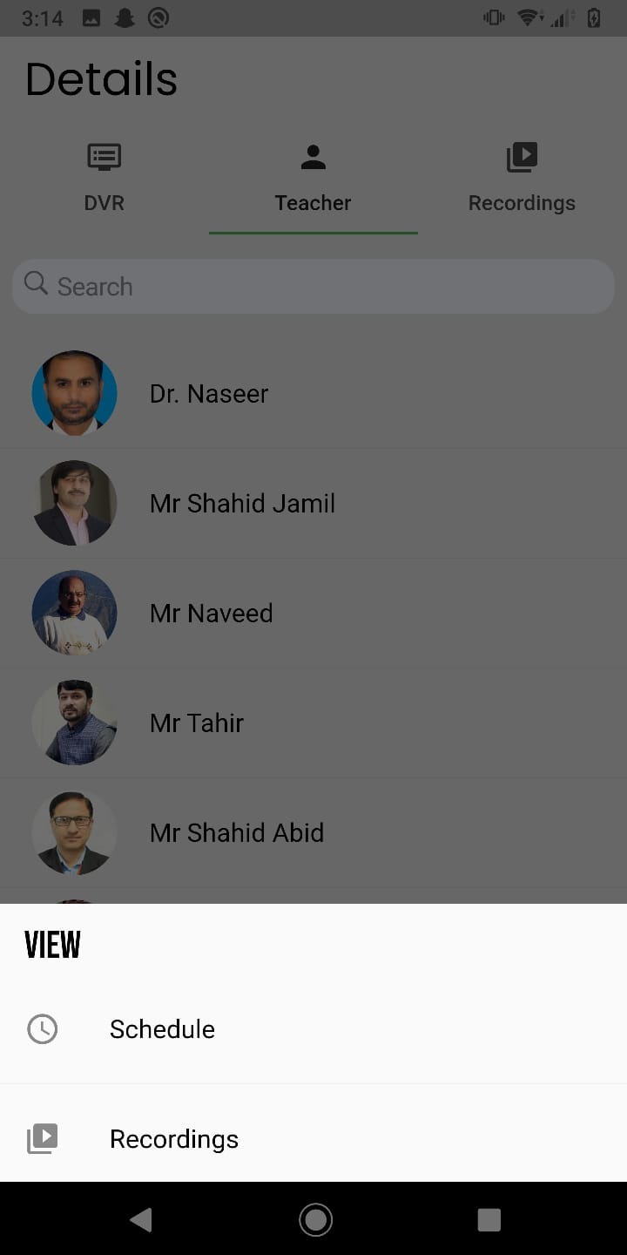
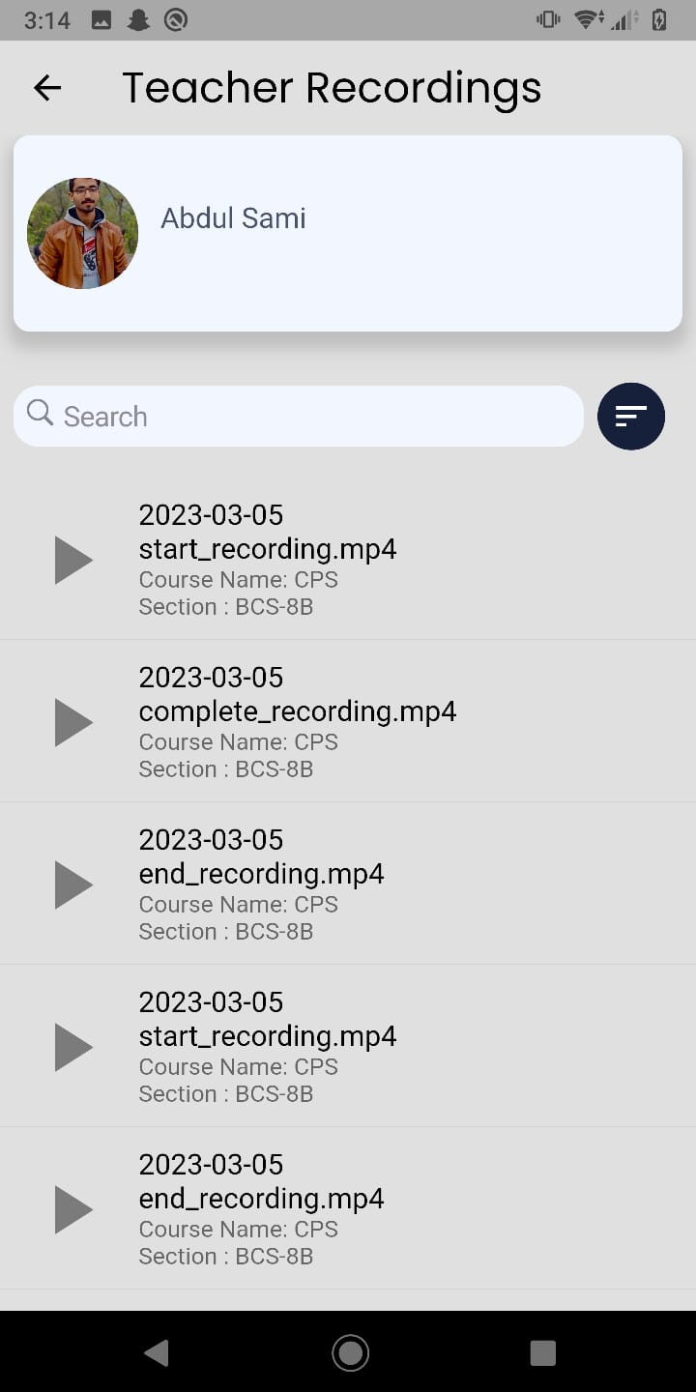
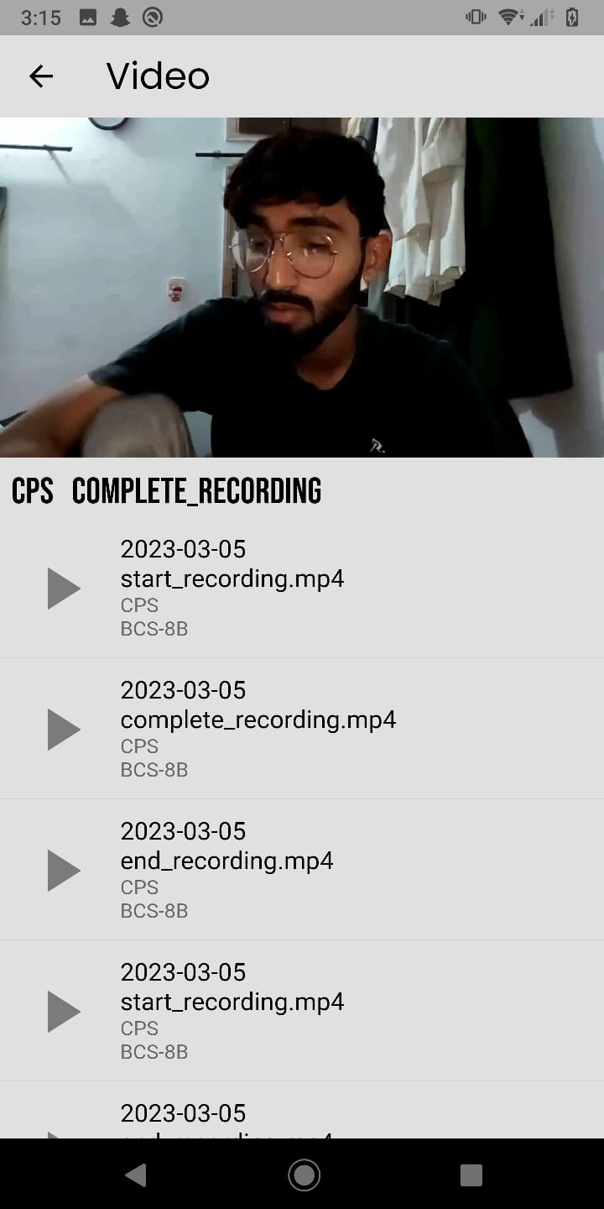
VIEW RECORDING BY TEACHER’S NAME

Slide 5
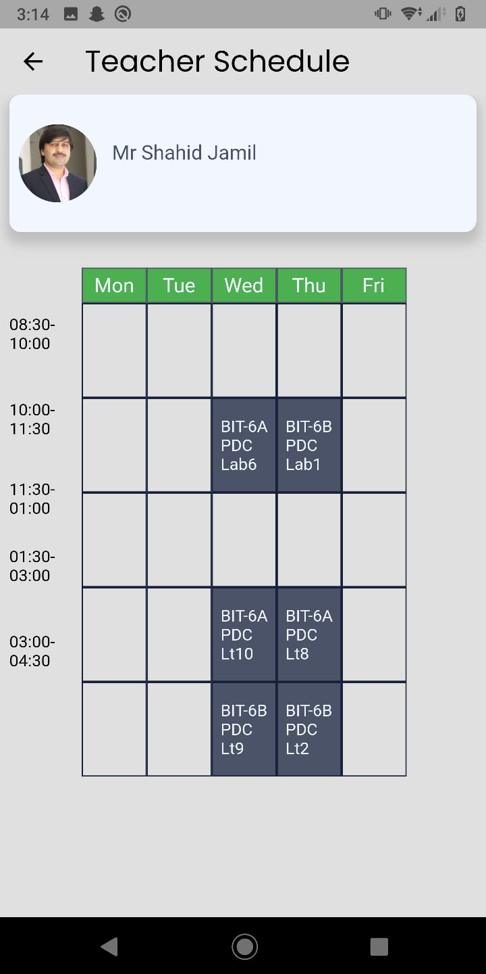
VIEW SCHEDULE BY TEACHER’S NAME

Slide 6
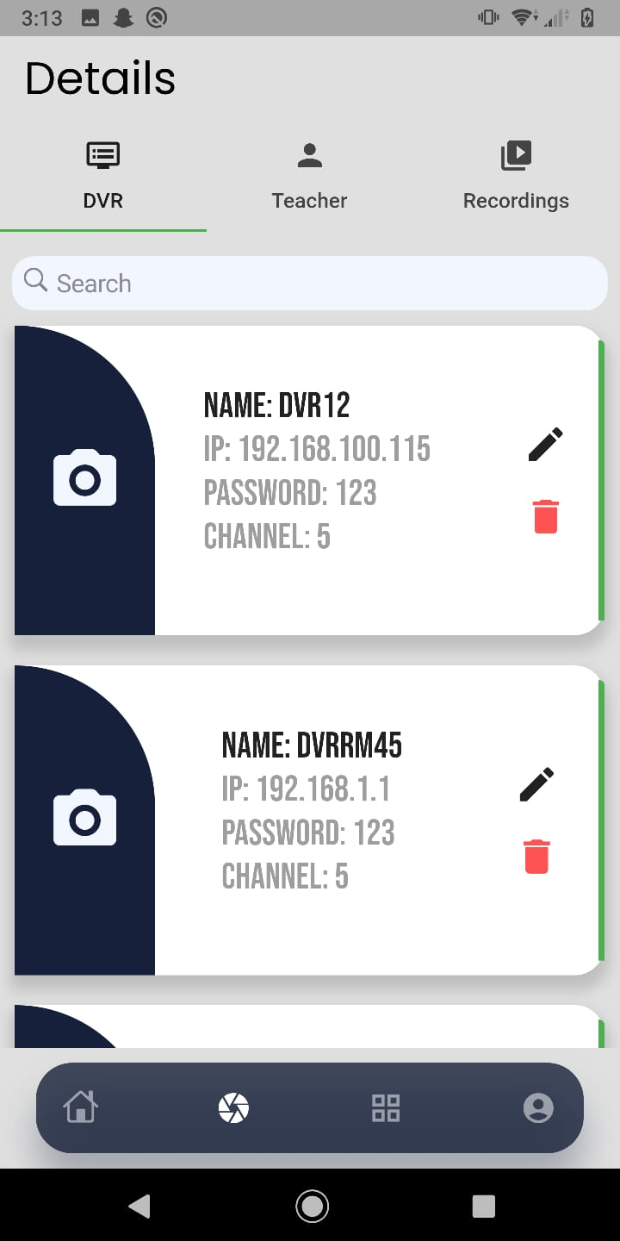
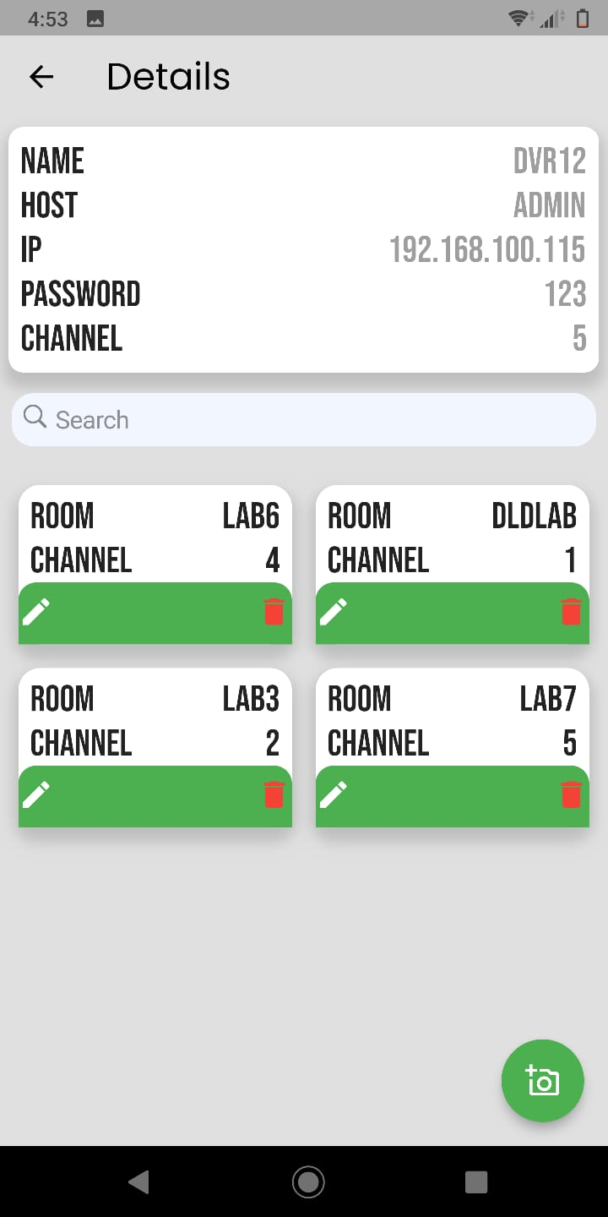
DVR Setting

Slide 7
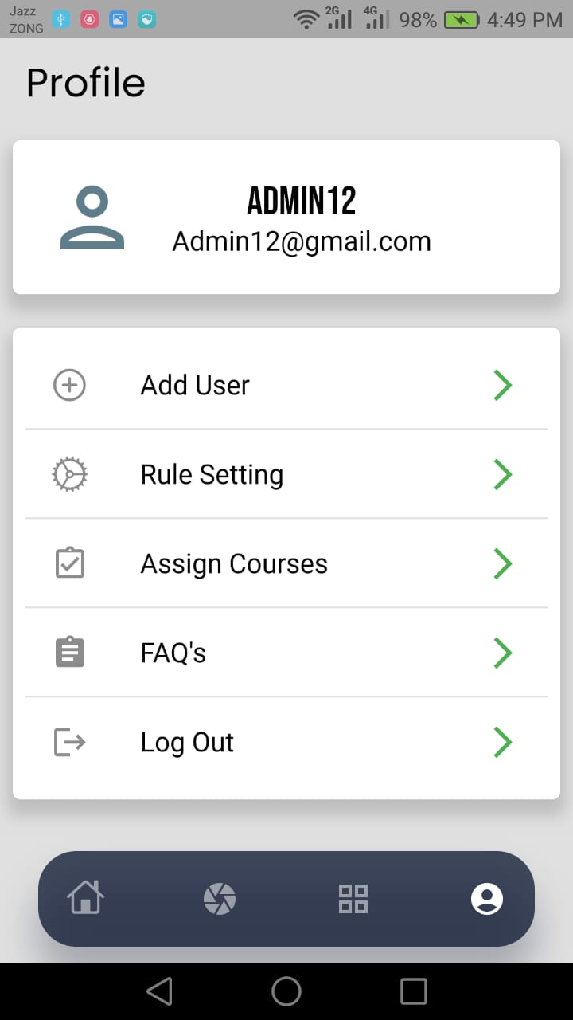
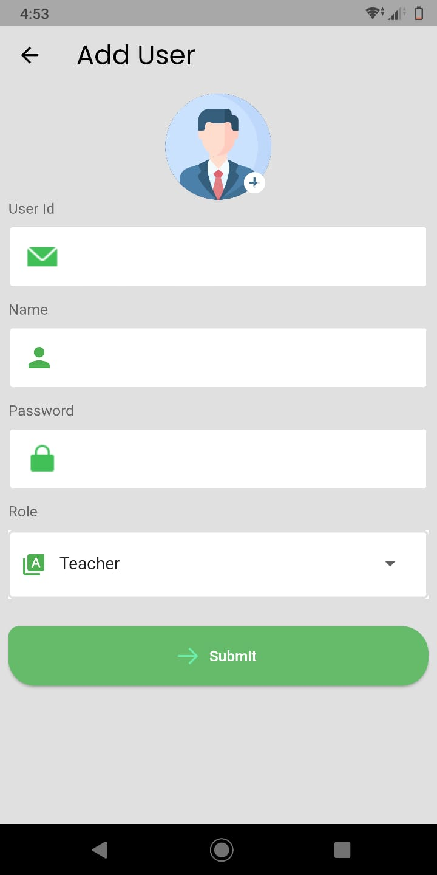
Add User

Slide 8
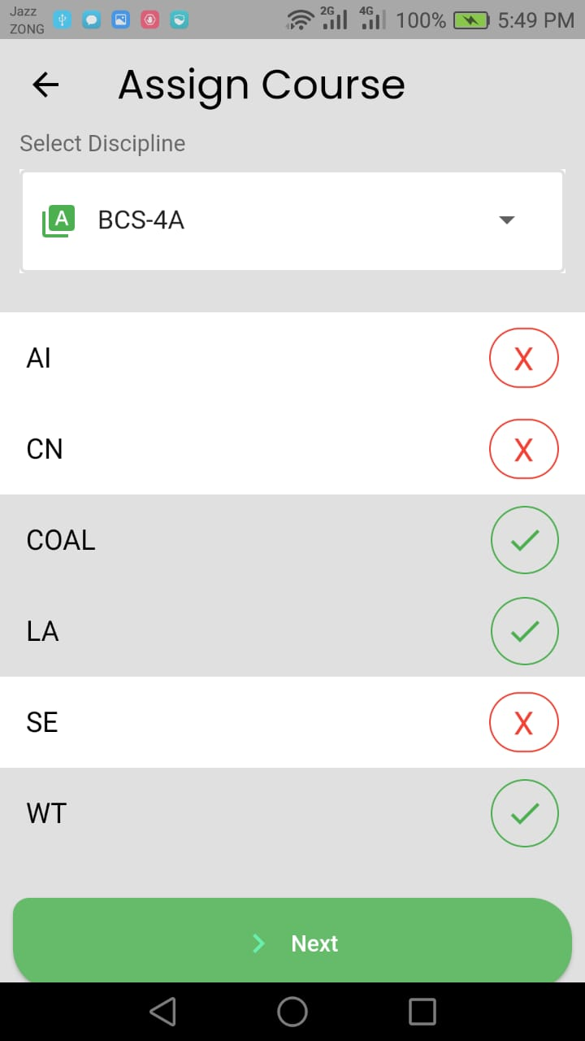
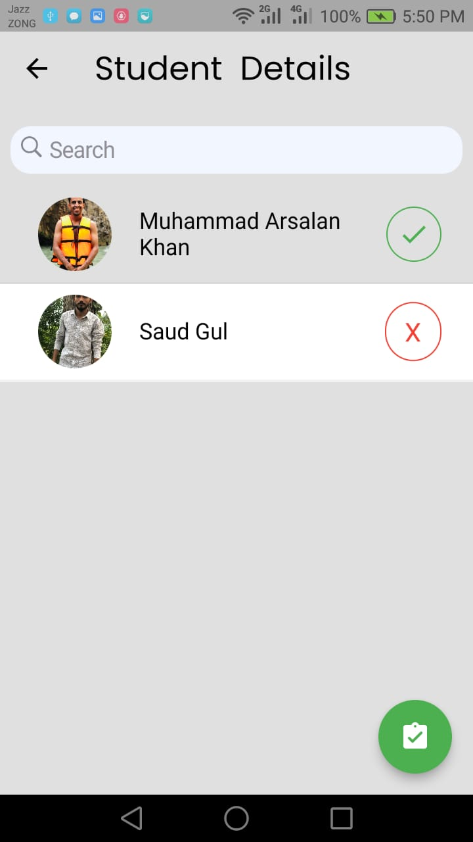
Assign Course

Slide 9
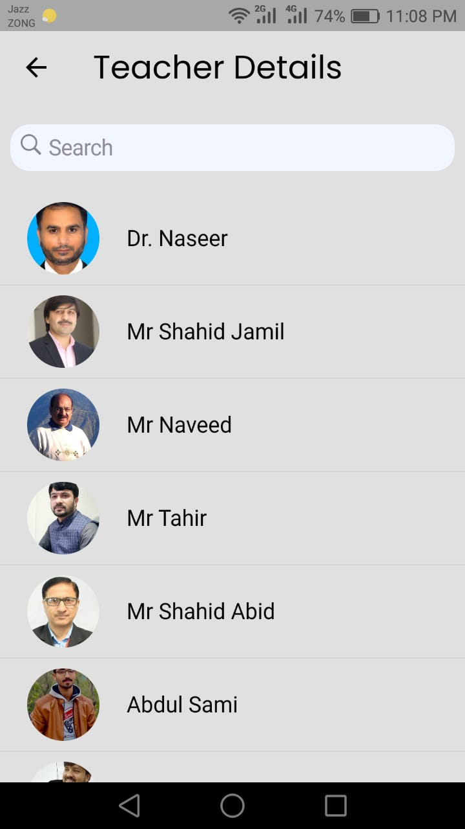
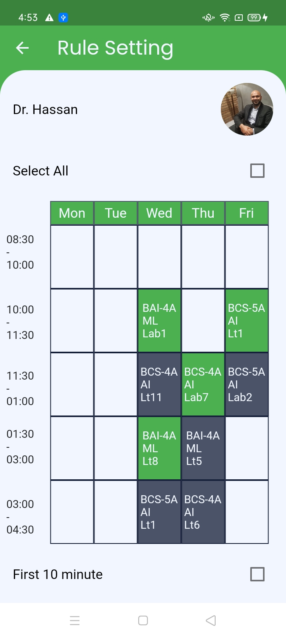
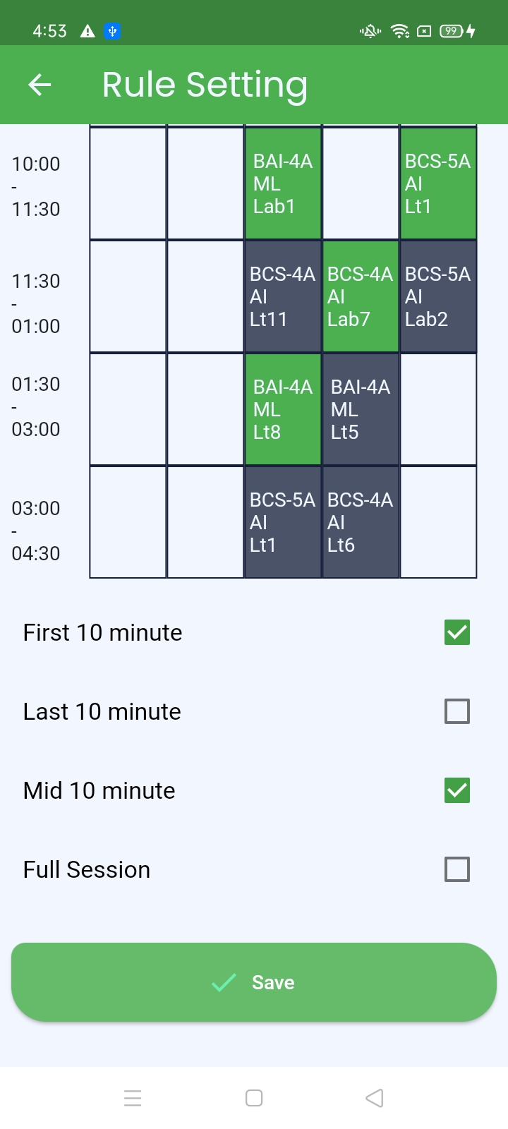
RULE SETTING

Slide 10
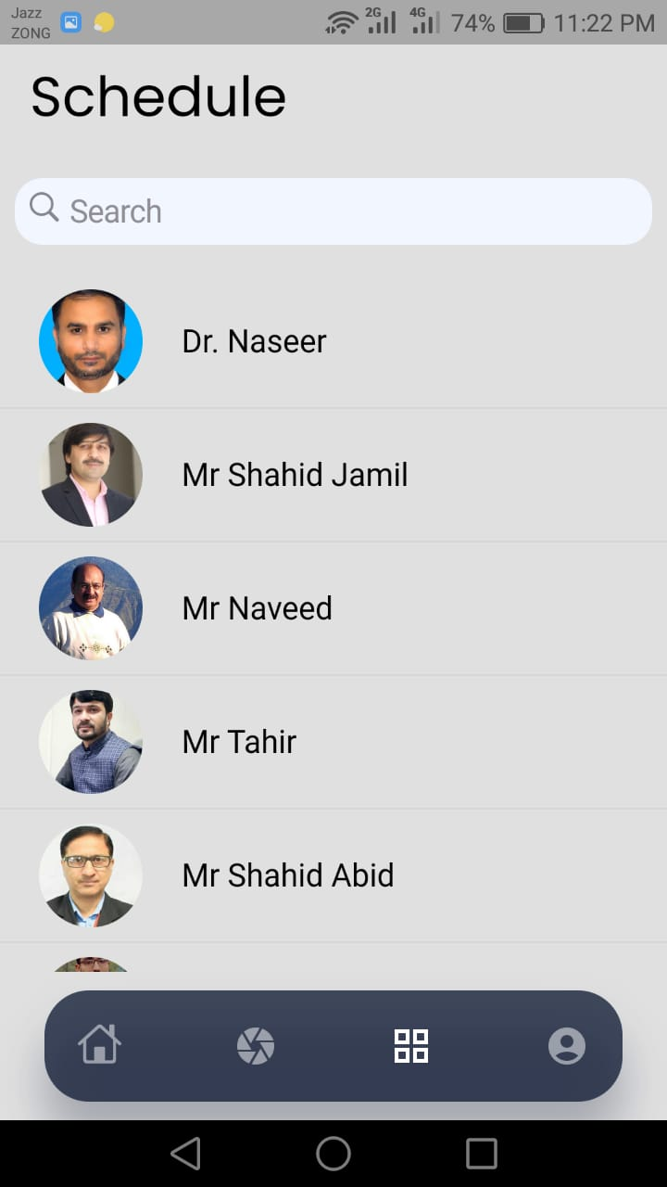
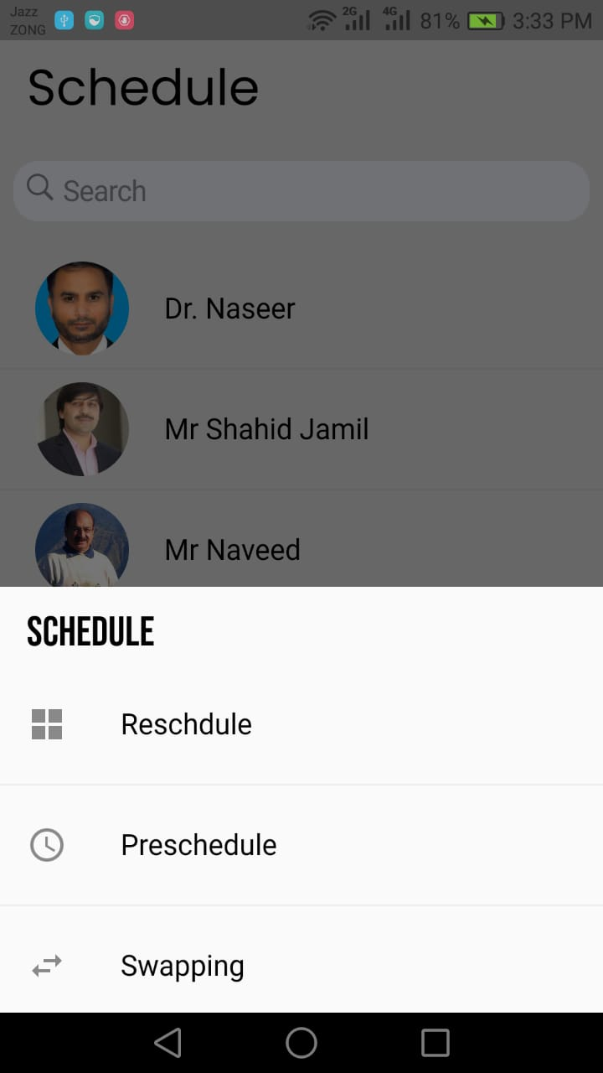
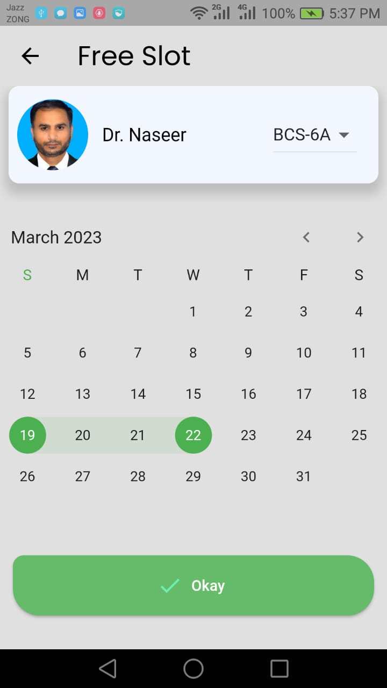
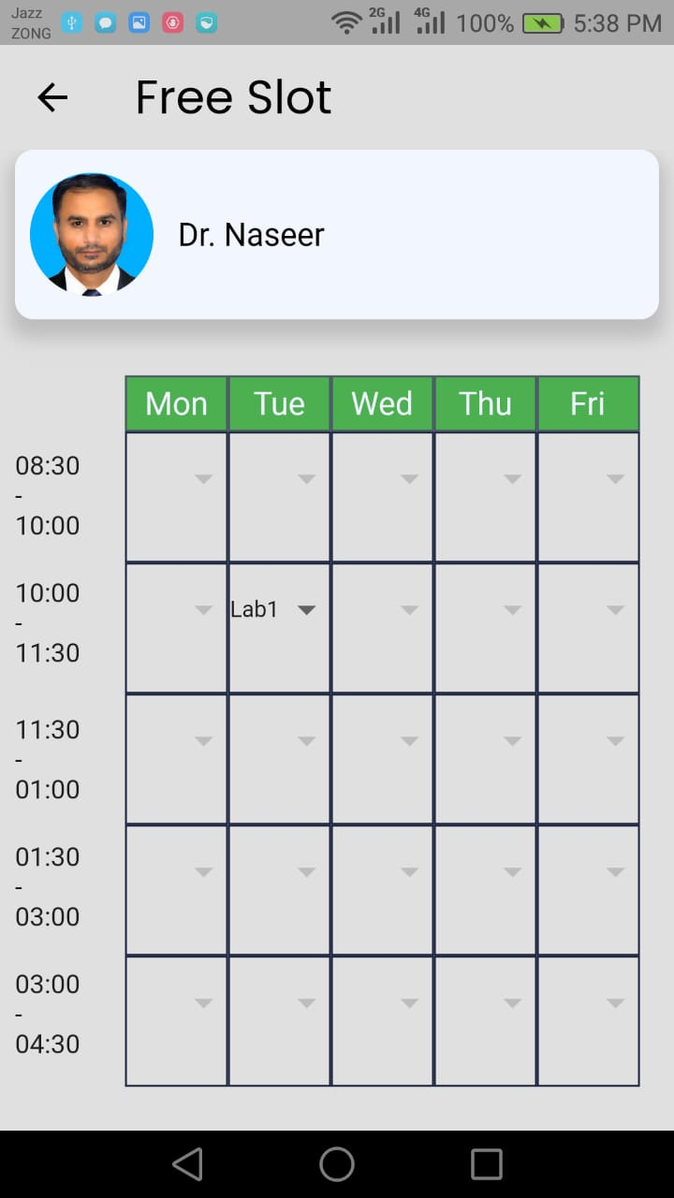
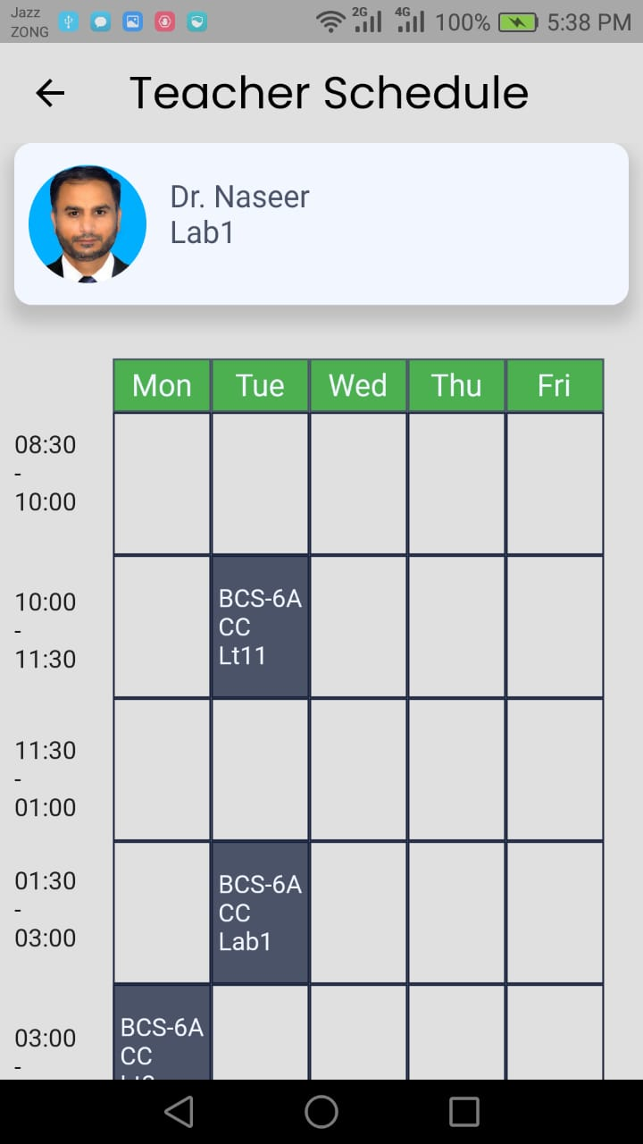
RESCHEDULING

Slide 11
PRESCHEDULING

Slide 12
SWAPPING

Slide 13
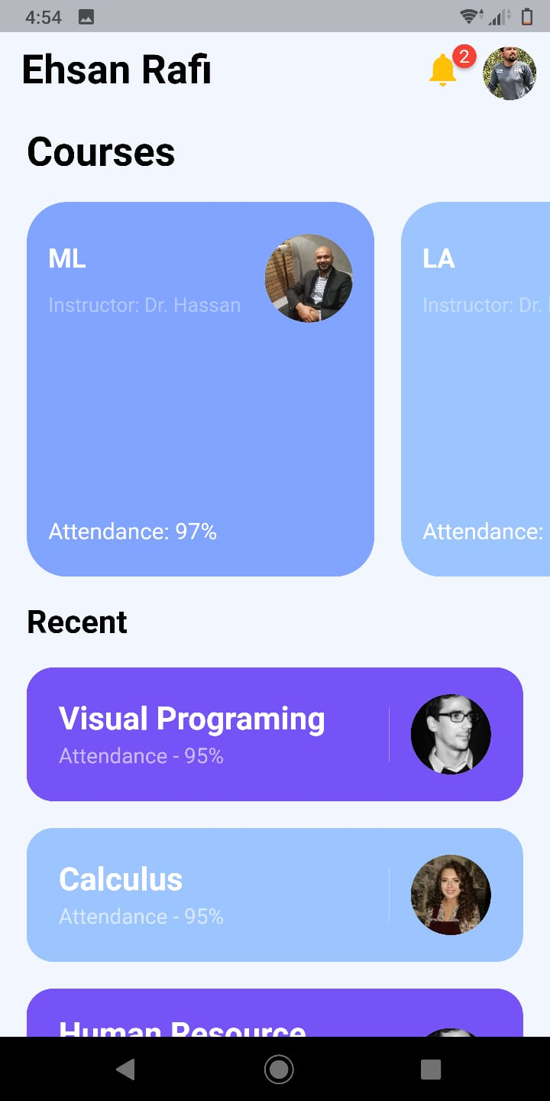
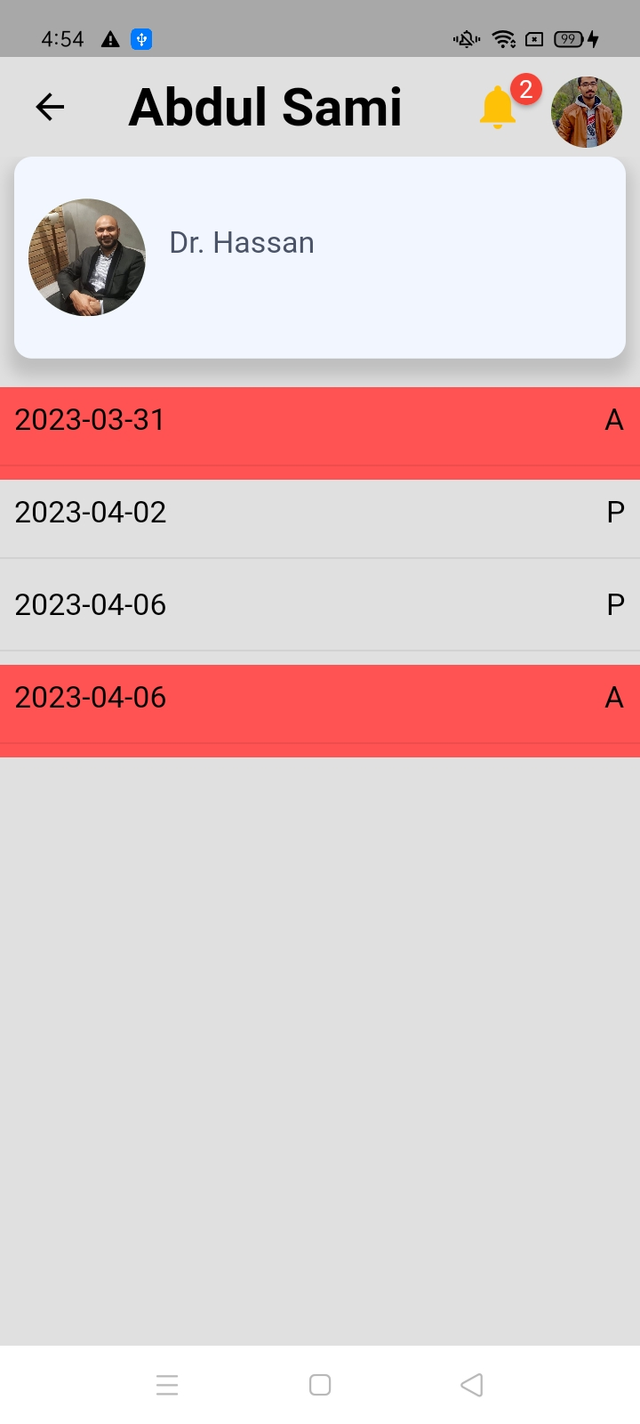
STUDENT Dashboard

Slide 14
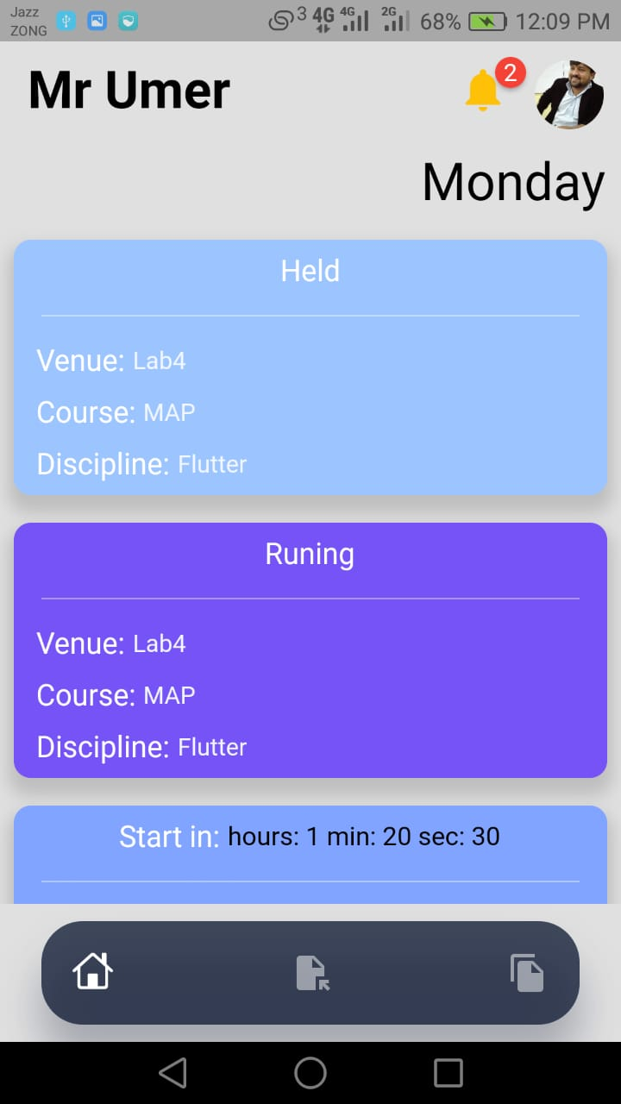
Teacher Dashboard

Slide 15
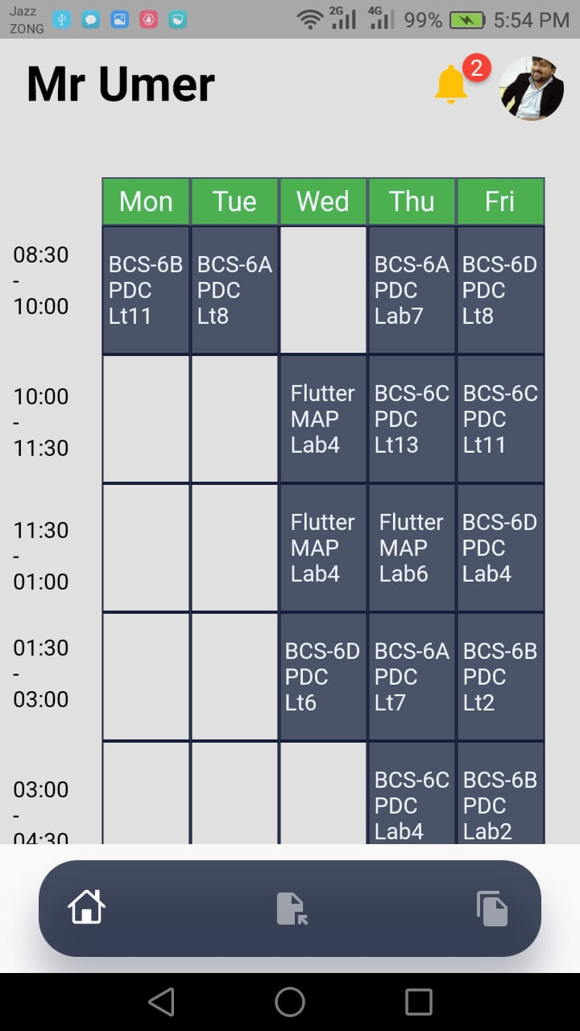
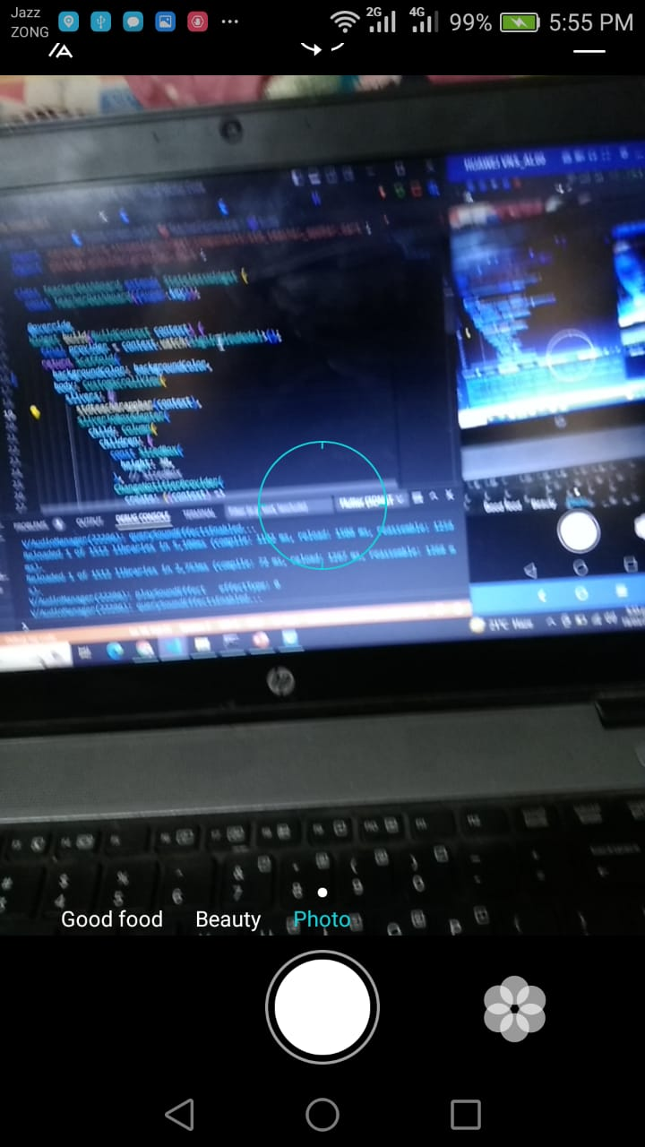
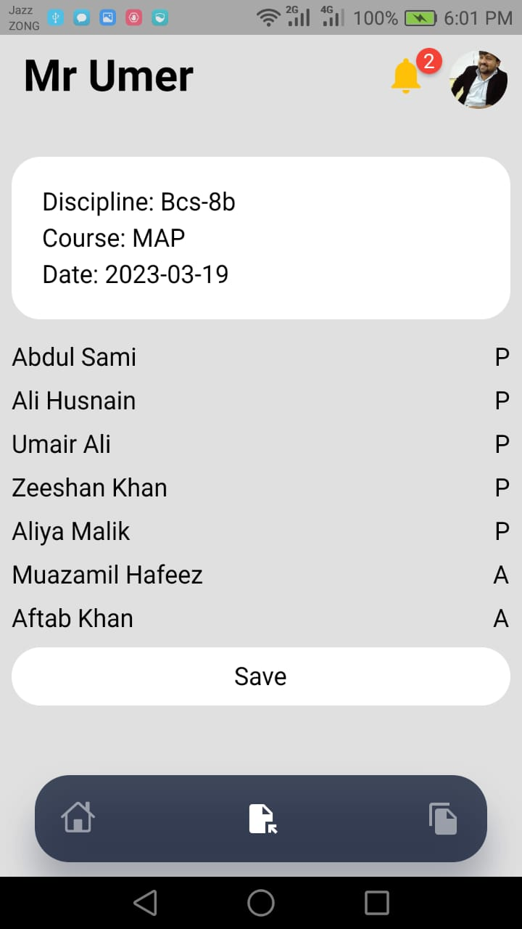
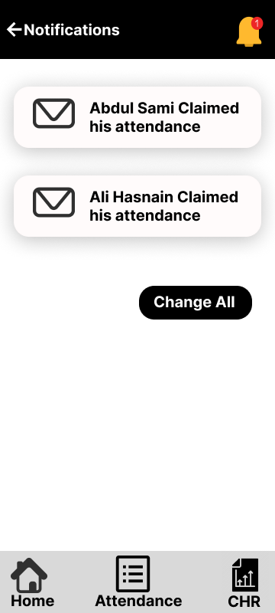
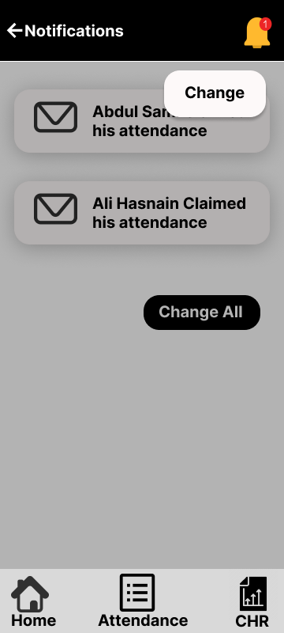
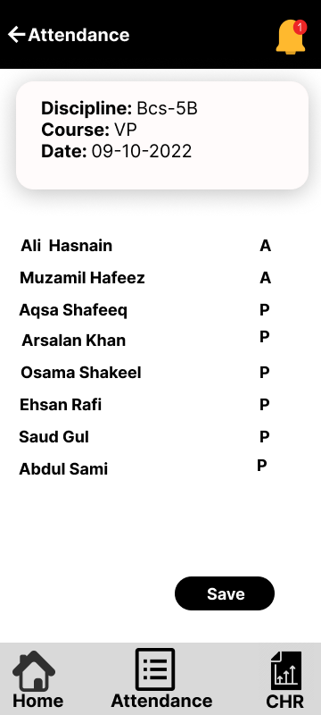
ATTENDANCE MARKING

Slide 16
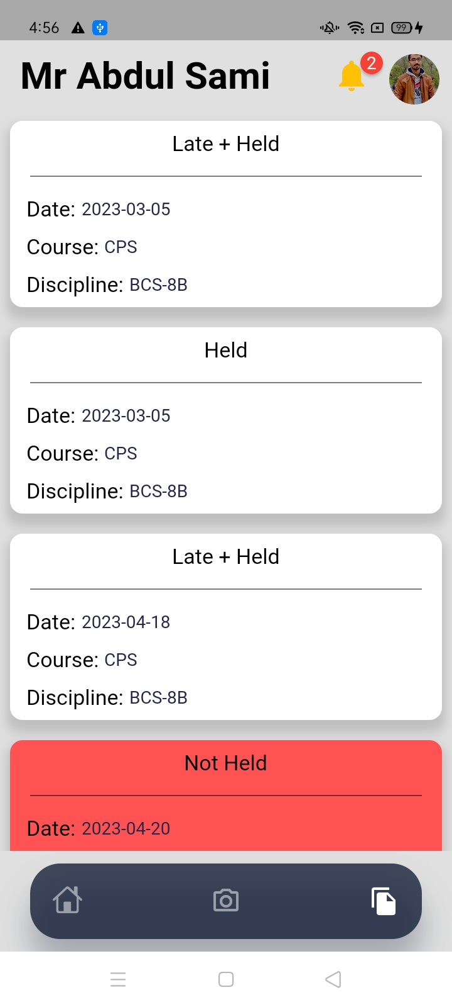
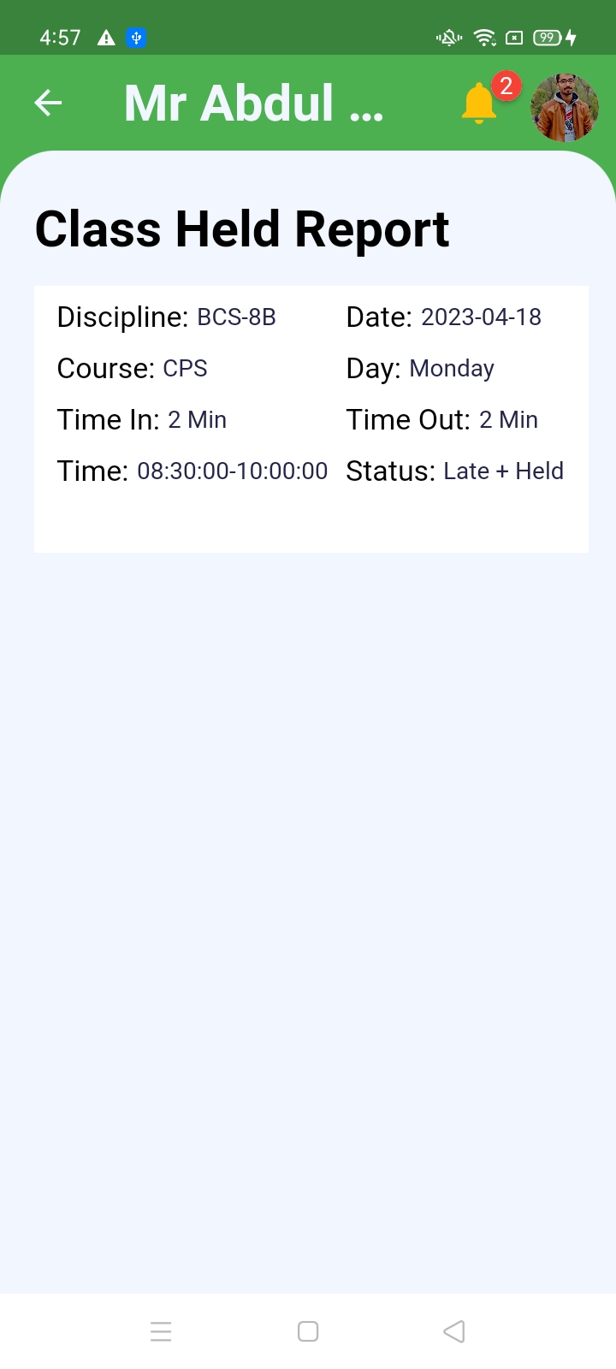
View CHR

Slide 17
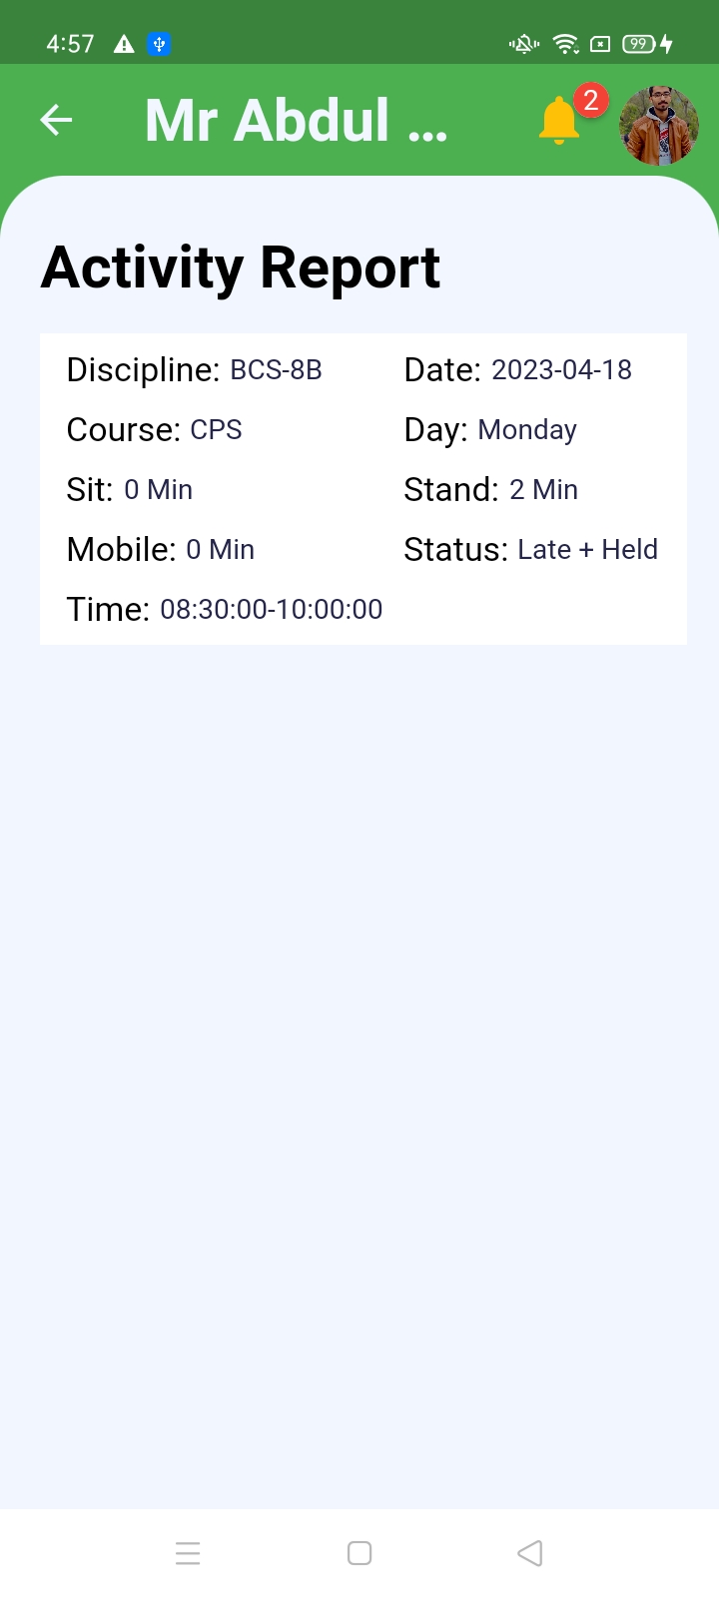
View Activity

Slide 18
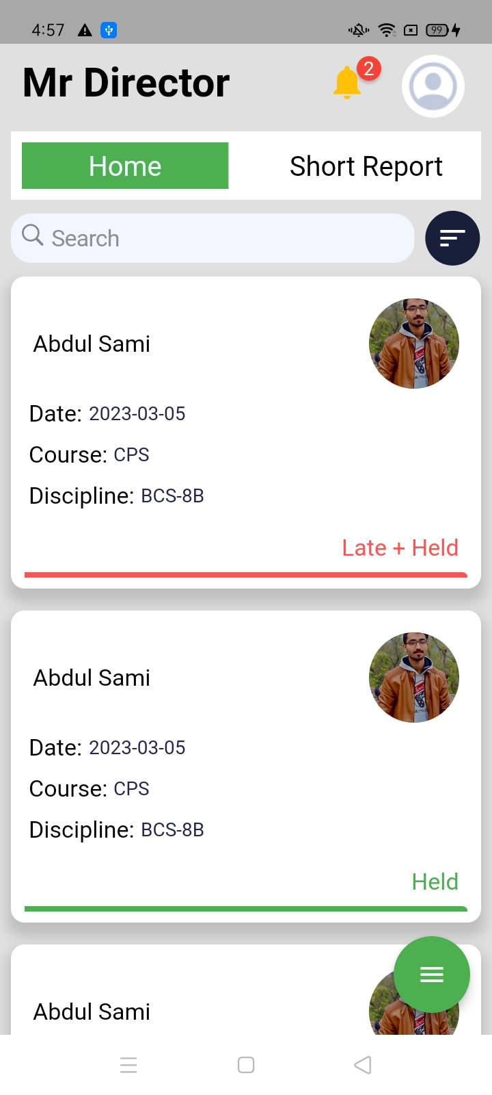
Director Dashboard

Slide 19
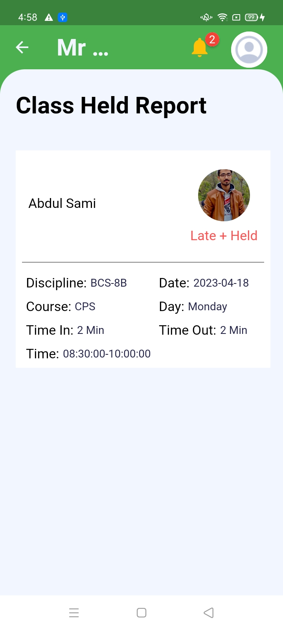
View Specific Teacher CHR

Slide 20
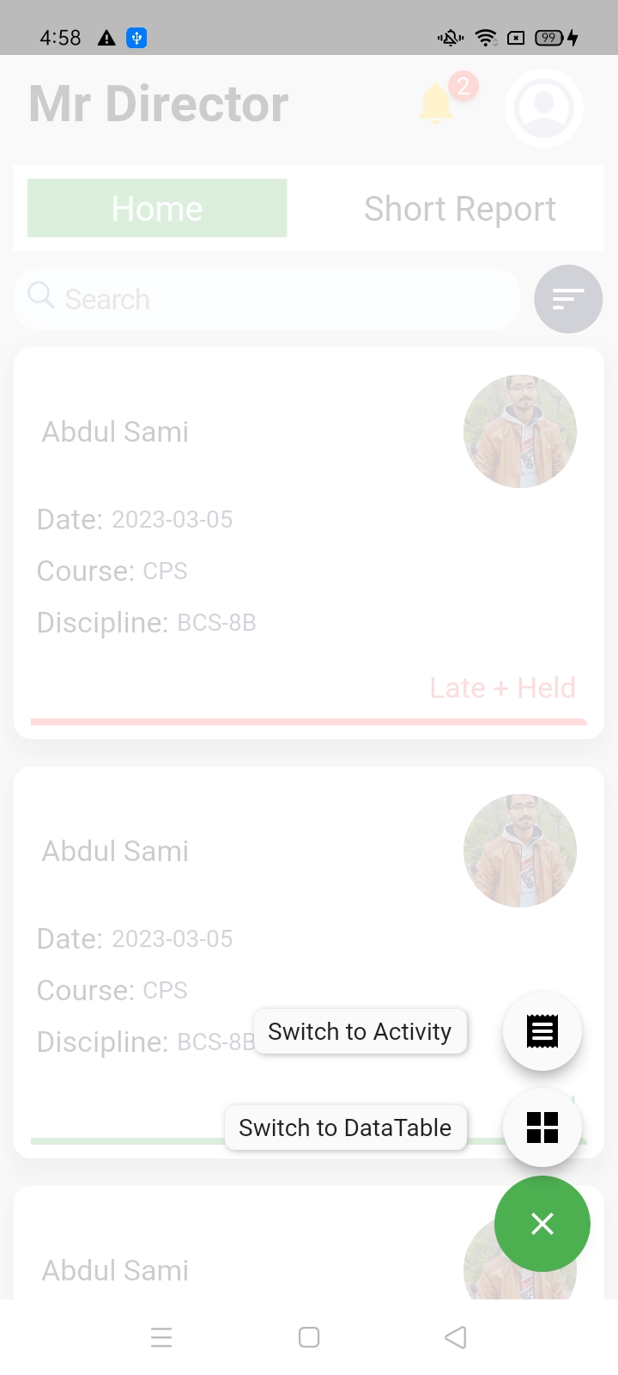
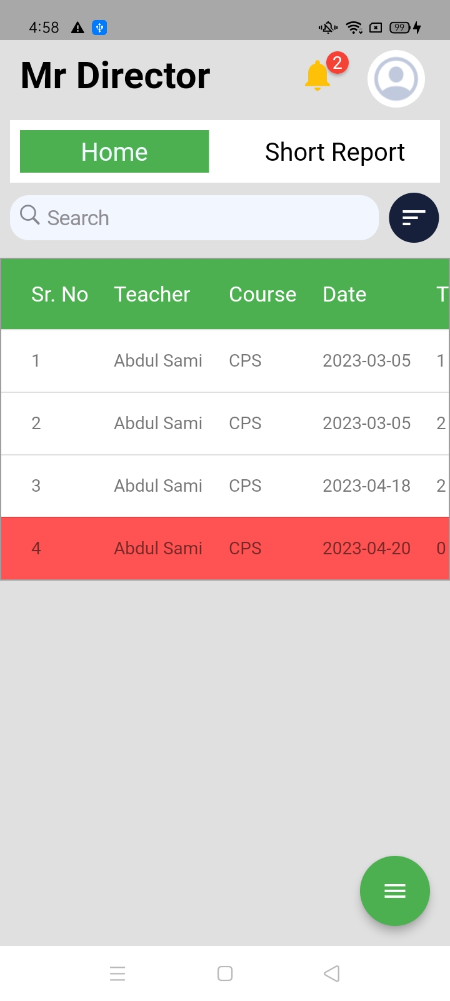
View Teacher CHR BY DataTable

Slide 21
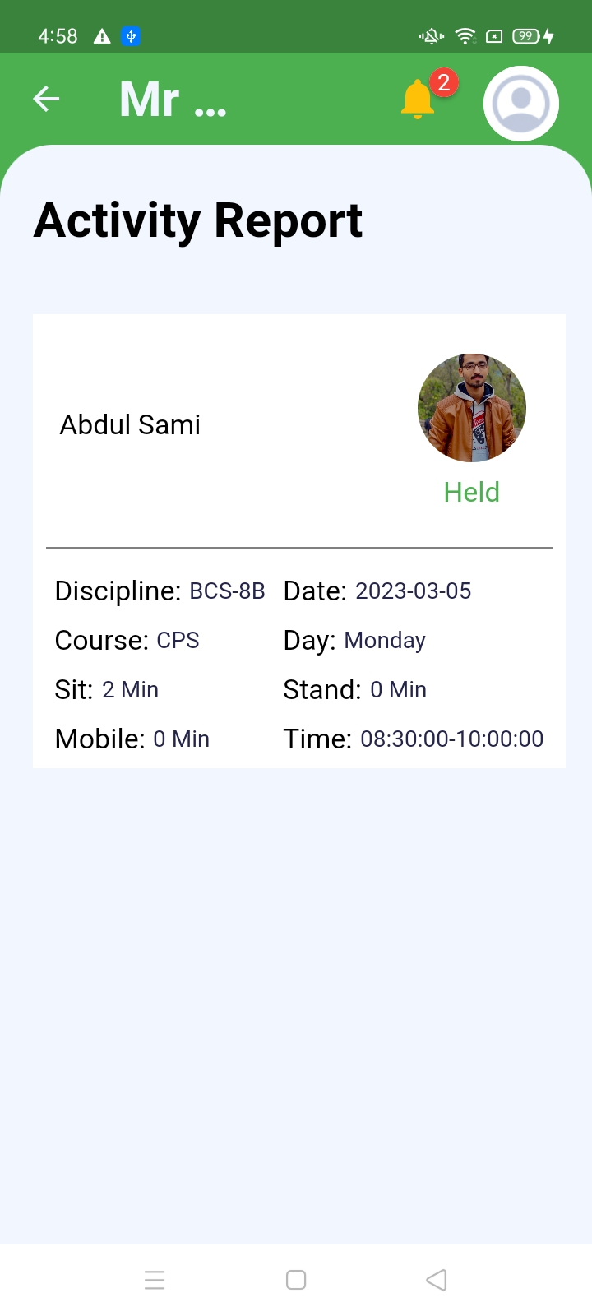
View Teacher Activity

Slide 22
View Teacher Activity BY DataTable

Slide 23
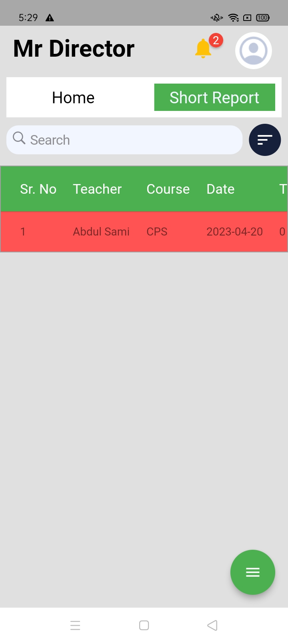
View Teacher Short Report BY DataTable

Slide 24
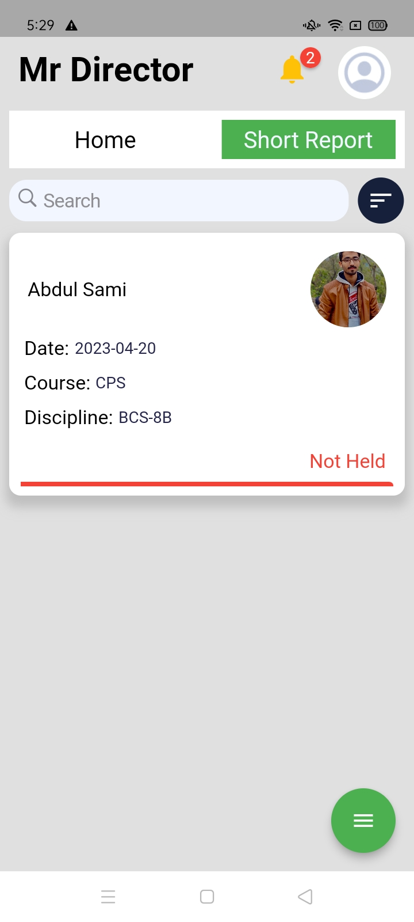

View Teacher Short Report

Slide 25
React Native View

Slide 26
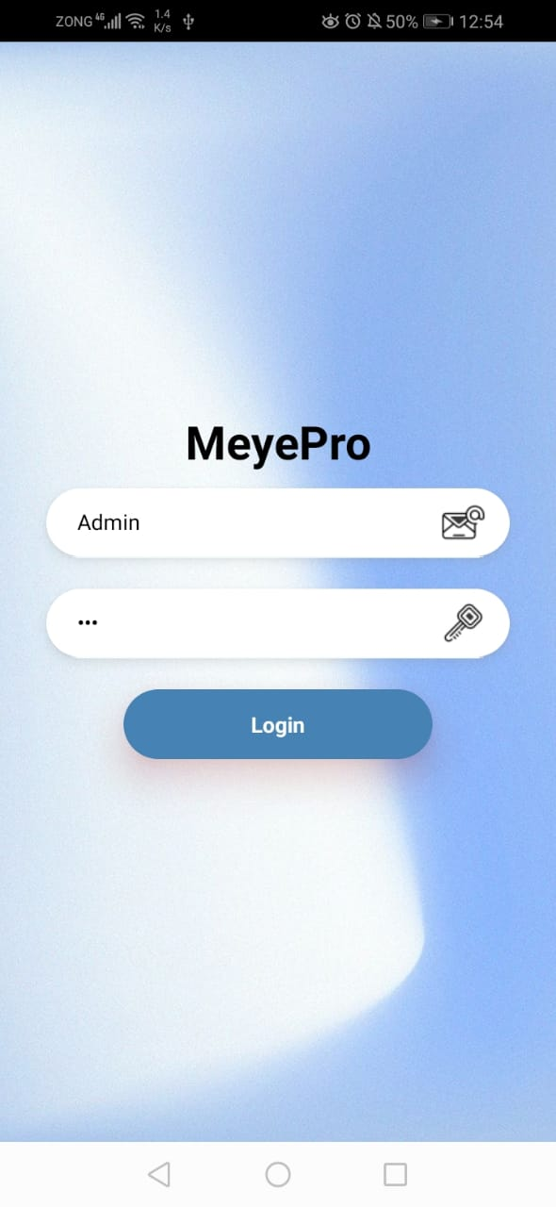
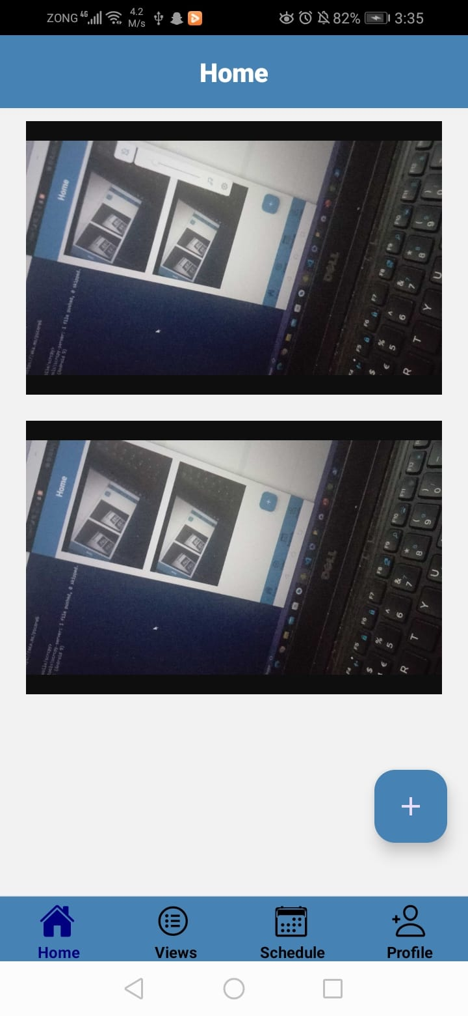
ADMIN’S SCREEN

Slide 27
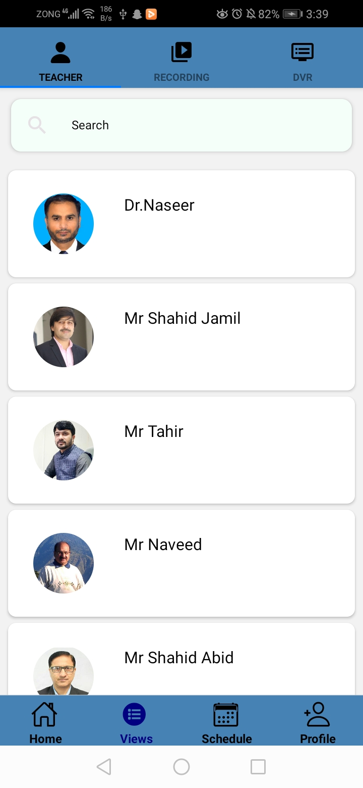
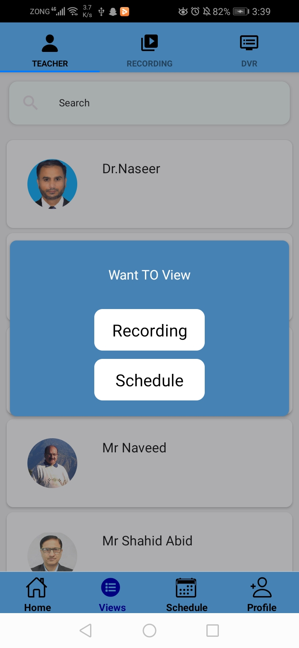
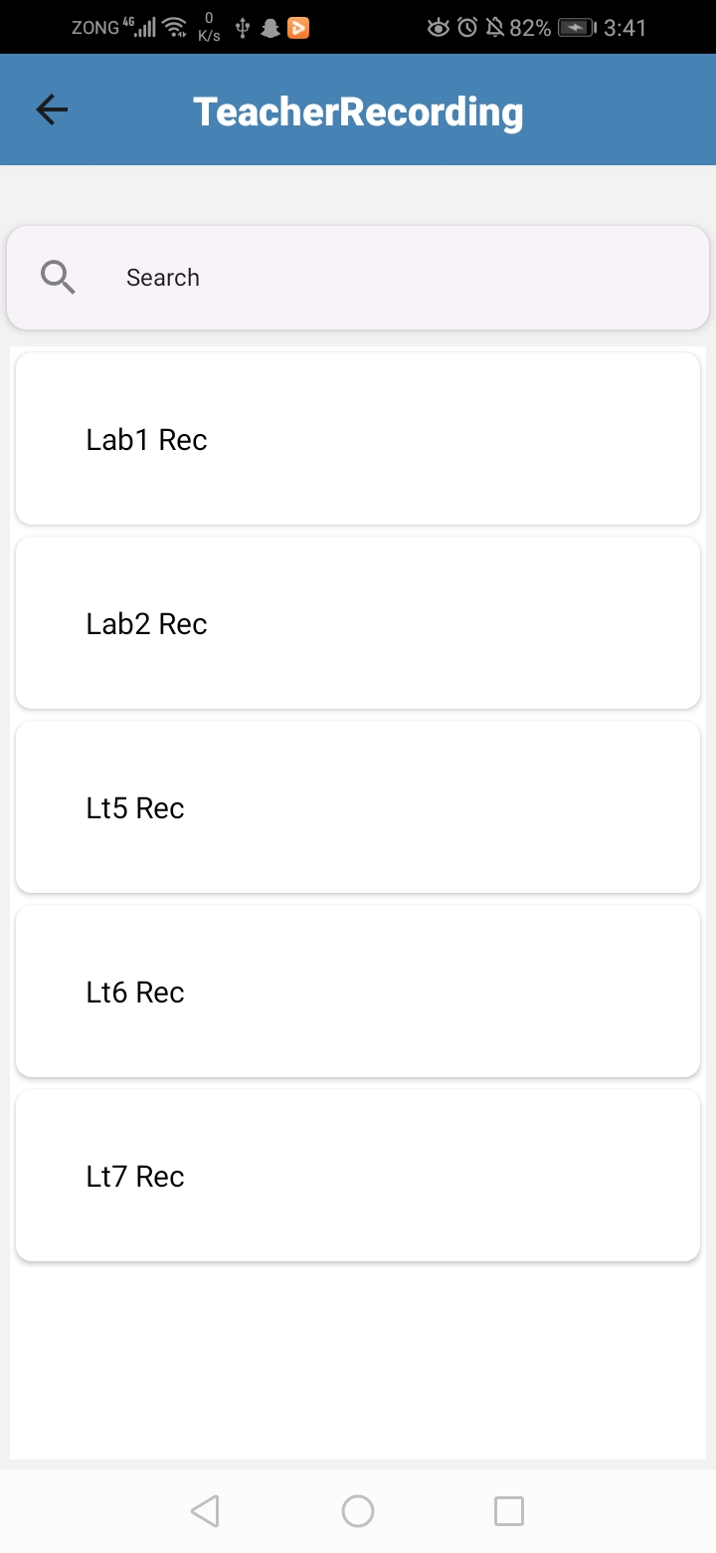
VIEW RECORDING BY TEACHER’S NAME

Slide 28
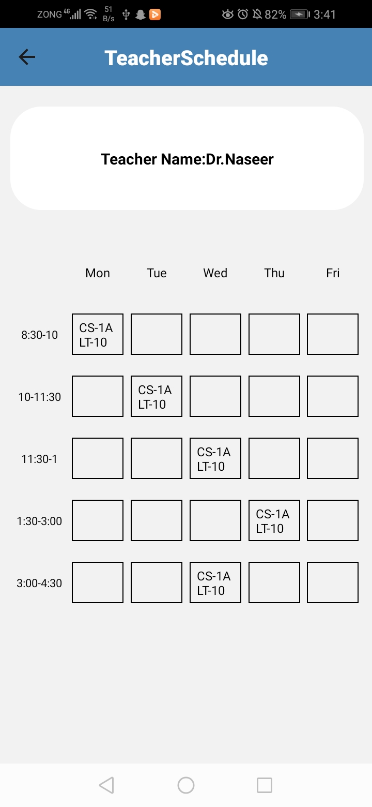
VIEW SCHEDULE BY TEACHER’S NAME

Slide 29
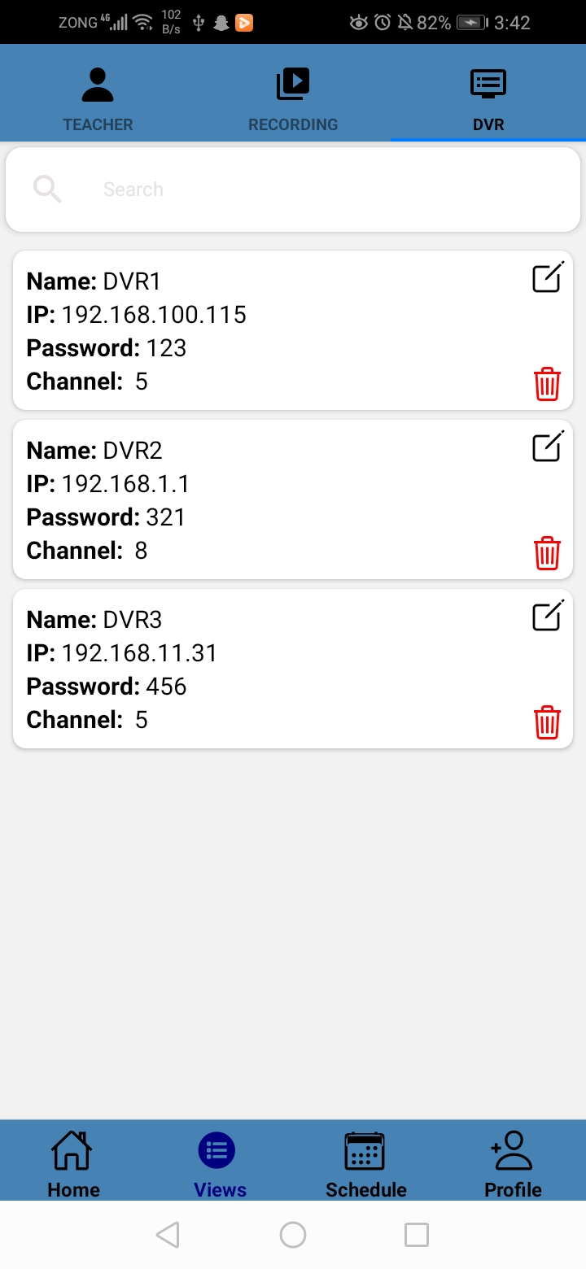
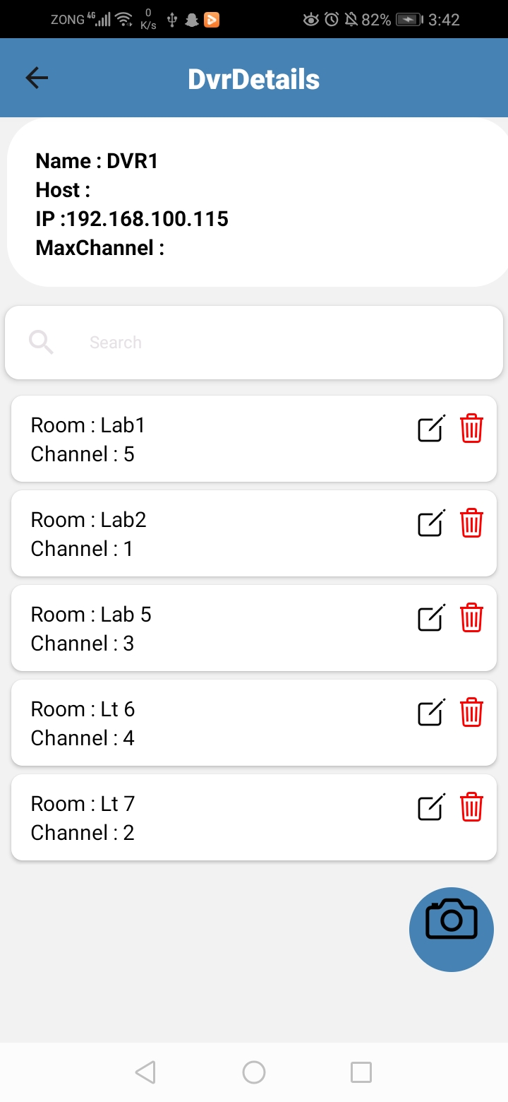
DVR Setting

Slide 30


Add User

Slide 31


Assign Courses

Slide 32


RULE SETTING

Slide 33





RESCHEDULING

Slide 34


PRESCHEDULING

Slide 35
SWAPPING

Slide 36


STUDENT’S VIEW

Slide 37

Teacher Dashboard

Slide 38


ATTENDANCE MARKING

Slide 39

SPECIFIC SESSION CHR

Slide 40

Director Dashboard

Slide 41

View CHR

Slide 42
React JS View

Slide 43


ADMIN’S SCREEN

Slide 44





VIEW RECORDING BY TEACHER’S NAME

Slide 45

VIEW SCHEDULE BY TEACHER’S NAME

Slide 46


DVR SETTING

Slide 47


ADD USER

Slide 48



ASSIGN COURSE

Slide 49




RULE SETTING

Slide 50




RESCHEDULING

Slide 51
PRESCHEDULING

Slide 52
SWAPPING

Slide 53


STUDENT’S VIEW

Slide 54

TEACHER VIEW

Slide 55


ATTENDANCE MARKING

Slide 56


VIEW CHR

Slide 57

DIRECTOR DASHBOARD

Slide 58

VIEW SPECIFIC TEACHER CHR

Slide 59

VIEW SPECIFIC TEACHER CHR BY DATATABLE

Slide 60
Android View

Slide 61




ADMIN’S SCREEN

Slide 62



VIEW RECORDING BY TEACHER’S NAME

Slide 63

VIEW SCHEDULE BY TEACHER’S NAME

Slide 64


VIEW RECORDING BY VENUE

Slide 65


VIEW RECORDING BY DVR

Slide 66


Add User

Slide 67



Assign Course

Slide 68




RULE SETTING

Slide 69


DVR SETTING

Slide 70


Upload Timetable

Slide 71





RESCHEDULING

Slide 72



PRESCHEDULING

Slide 73


SWAPPING

Slide 74




STUDENT Dashboard

Slide 75

STUDENT Claim Attendance

Slide 76

Teacher Dashboard

Slide 77


ATTENDANCE MARKING

Slide 78


View CHR

Slide 79

Director Dashboard

Slide 80

CHR VIEW(DIRECTOR)

Slide 81



View Teacher Activity(Tabular View)

